Slide 1
Why run:ai?
November | 2022

Slide 2
Utilization vs Allocation

Slide 3
Utilization vs Allocation
People sometimes confuse utilization for allocation, but they are not the same.
Notes:
MLOps pipeline

Slide 4
Utilization vs Allocation
People sometimes confuse utilization for allocation, but they are not the same.
Allocation refers to the assignment of a certain resource (GPUs, in our case) for use.
Notes:
MLOps pipeline

Slide 5



Utilization vs Allocation
People sometimes confuse utilization for allocation, but they are not the same.
Allocation refers to the assignment of a certain resource (GPUs, in our case) for use.
Data Scientist
GPU-1
GPU-1
GPU-2
Time GPU is assigned for use
Notes:
MLOps pipeline

Slide 6
Utilization vs Allocation
People sometimes confuse utilization for allocation, but they are not the same.
Allocation refers to the assignment of a certain resource (GPUs, in our case) for use.
Utilization refers to the use of a certain resource (GPUs, in our case) while in allocated.
Data Scientist
GPU-1
GPU-1
GPU-2
Time GPU is assigned for use
Notes:
MLOps pipeline

Slide 7
Utilization vs Allocation
People sometimes confuse utilization for allocation, but they are not the same.
Allocation refers to the assignment of a certain resource (GPUs, in our case) for use.
Utilization refers to the use of a certain resource (GPUs, in our case) while in allocated.
Data Scientist
GPU 1
usage
GPU-1
Time
GPU-1
GPU 2
usage
GPU-2
Time GPU is assigned for use
Time
Notes:
MLOps pipeline

Slide 8
Utilization vs Allocation
People sometimes confuse for with allocation, but they are not the same.
Allocation refers to the assignment of a certain resource (GPUs, in our case) for use.
Utilization refers to the use of a certain resource (GPUs, in our case) while in allocated.
Data Scientist
GPU 1
usage
GPU-1
Time
GPU-1
GPU 2
usage
GPU-2
Time GPU is assigned for use
Time
A GPU can be allocated…
Notes:
MLOps pipeline

Slide 9
Utilization vs Allocation
People sometimes confuse utilization for allocation, but they are not the same.
Allocation refers to the assignment of a certain resource (GPUs, in our case) for use.
Utilization refers to the use of a certain resource (GPUs, in our case) while in allocated.
Data Scientist
GPU 1
usage
GPU-1
Time
GPU-1
GPU 2
usage
GPU-2
Time GPU is assigned for use
Time
A GPU can be allocated…
…but not utilized
Notes:
MLOps pipeline

Slide 10
Example of Utilization vs Allocation, with TensorFlow
Notes:
MLOps pipeline

Slide 11
Example of Utilization vs Allocation, with TensorFlow
By default, TensorFlow allocates all GPU memory to itself, regardless of how much it needs.
Notes:
MLOps pipeline

Slide 12
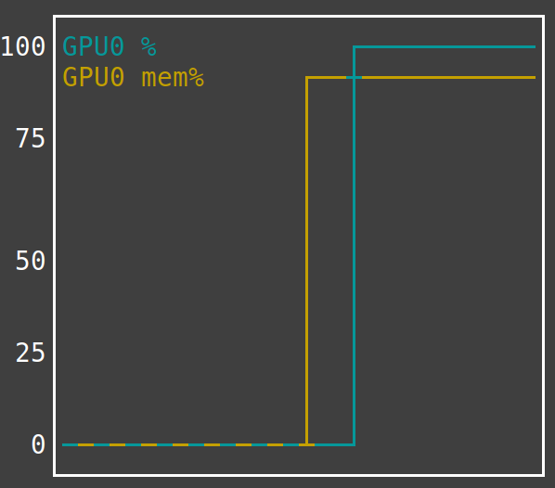
Example of Utilization vs Allocation, with TensorFlow
By default, TensorFlow allocates all GPU memory to itself, regardless of how much it needs.
(default)
Notes:
MLOps pipeline

Slide 13
Example of Utilization vs Allocation, with TensorFlow
By default, TensorFlow allocates all GPU memory to itself, regardless of how much it needs.
Only by setting the TF_FORCE_GPU_ALLOW_GROWTH variable to true, will TensorFlow only allocate needed GPU memory.
(default)
Notes:
MLOps pipeline

Slide 14
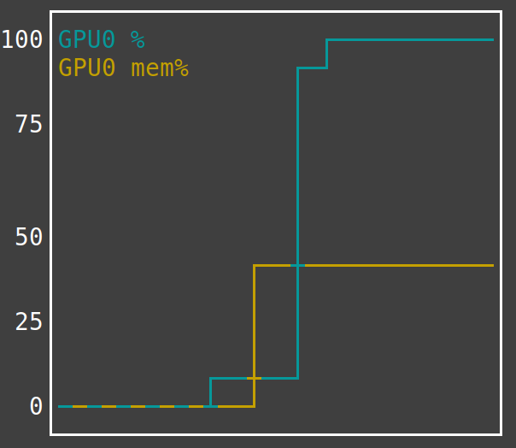
Example of Utilization vs Allocation, with TensorFlow
By default, TensorFlow allocates all GPU memory to itself, regardless of how much it needs.
Only by setting the TF_FORCE_GPU_ALLOW_GROWTH variable to true, will TensorFlow only allocate needed GPU memory.
(default)
export TF_FORCE_GPU_ALLOW_GROWTH=true
Notes:
MLOps pipeline

Slide 15
Example of Utilization vs Allocation, with TensorFlow
By default, TensorFlow allocates all GPU memory to itself, regardless of how much it needs.
Only by setting the TF_FORCE_GPU_ALLOW_GROWTH variable to true, will TensorFlow only allocate needed GPU memory.
(default)
export TF_FORCE_GPU_ALLOW_GROWTH=true
One might think they are fully utilizing their GPU memory….
Notes:
MLOps pipeline

Slide 16
Example of Utilization vs Allocation, with TensorFlow
By default, TensorFlow allocates all GPU memory to itself, regardless of how much it needs.
Only by setting the TF_FORCE_GPU_ALLOW_GROWTH variable to true, will TensorFlow only allocate needed GPU memory.
(default)
export TF_FORCE_GPU_ALLOW_GROWTH=true
One might think they are fully utilizing their GPU memory….
…when in fact, they are not.
Notes:
MLOps pipeline

Slide 17
Ideal GPU Utilization

Slide 18
In a perfect world…
Time
Notes:
MLOps pipeline

Slide 19
In a perfect world…
GPU Utilization over time
GPU 1
GPU 2
GPU 3
GPU 4
Avg
Time
Notes:
MLOps pipeline

Slide 20
In a perfect world…
GPU Utilization over time
GPU 1
We would fully utilize all GPUs, at all times.
GPU 2
GPU 3
GPU 4
Avg
Time
Notes:
MLOps pipeline

Slide 21
In a perfect world…
GPU Utilization over time
GPU 1
We would fully utilize all GPUs, at all times.
GPU 2
GPU 3
GPU 4
Therefore, our metric of interest is: Average GPU utilization over time
Avg
Time
Notes:
MLOps pipeline

Slide 22
Sub-optimal GPU Utilization

Slide 23
In real life…
Notes:
MLOps pipeline

Slide 24
In real life…
GPUs are ridiculously underutilized!
Notes:
MLOps pipeline

Slide 25
In real life…
GPUs are ridiculously underutilized! Avg Util Over Time is almost always less than 10%!
Notes:
MLOps pipeline

Slide 26
In real life…
GPUs are ridiculously underutilized! Avg Util Over Time is almost always less than 10%! Why?
Notes:
MLOps pipeline

Slide 27
Example: GPU usage during ‘analysis’

Slide 28
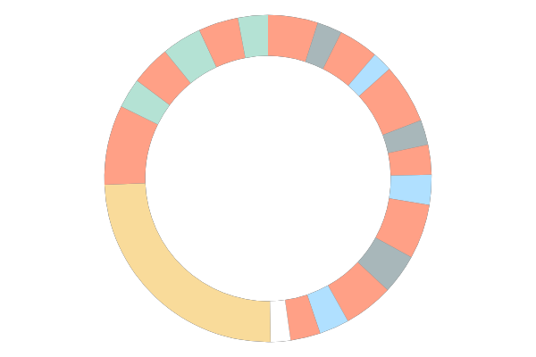
Example: GPU usage during ‘analysis’
dataset collection
analysis
ETL
train
inference
12
GPU POWERED WORKFLOW
9
3
6
developer.nvidia.com/blog/gpu-accelerated-analytics-rapids/

Slide 29
Example: GPU usage during ‘analysis’
dataset collection
analysis
ETL
train
inference
12
GPU POWERED WORKFLOW
9
3
6
developer.nvidia.com/blog/gpu-accelerated-analytics-rapids/

Slide 30
Example: GPU usage during ‘analysis’
During Analysis,
most time is spent writing code.
Intermittently run segments of code to test.
dataset collection
analysis
ETL
train
inference
12
GPU POWERED WORKFLOW
9
3
6
developer.nvidia.com/blog/gpu-accelerated-analytics-rapids/

Slide 31
Example: GPU usage during ‘analysis’
During Analysis,
most time is spent writing code.
Intermittently run segments of code to test.
dataset collection
analysis
ETL
train
inference
12
GPU 1
GPU POWERED WORKFLOW
9
3
Time
During analysis, most of my time I am not utilizing the GPU to its fullest capacity.
6
developer.nvidia.com/blog/gpu-accelerated-analytics-rapids/

Slide 32
In real life…
GPUs are ridiculously underutilized! Avg Util Over Time is almost always less than 10%! Why?
During initial analysis/prototyping, most time is spent writing and developing code/scripts. The only time the GPU is used is during sporadic testing of code.
GPU Utilization over time
GPU 1
GPU 2
GPU 3
GPU 4
Avg
Time
This is where we see the absolute lowest Average Utilization.
Notes:
MLOps pipeline

Slide 33
In real life…
GPUs are ridiculously underutilized! Avg Util Over Time is almost always less than 10%! Why?
During initial analysis/prototyping, most time is spent writing and developing code/scripts. The only time the GPU is used is during sporadic testing of code.
Sometimes the model(s) we are training is very small (or very simple), or the ETL pipeline we are running is not complex.
GPU Utilization over time
GPU Utilization over time
GPU 1
GPU 1
GPU 2
GPU 2
GPU 3
GPU 3
GPU 4
GPU 4
Avg
Avg
Time
Time
This is where we see the absolute lowest Average Utilization.
In these cases, we get more consistent utilization, but still do not saturate our GPUs.
Notes:
MLOps pipeline

Slide 34
In real life…
GPUs are ridiculously underutilized! Avg Util Over Time is almost always less than 10%! Why?
During initial analysis/prototyping, most time is spent writing and developing code/scripts. The only time the GPU is used is during sporadic testing of code.
Sometimes the model(s) we are training is very small (or very simple), or the ETL pipeline we are running is not complex.
We might sometimes need to train a series of large/complex models, or complex ETL pipelines, but we don’t run them back-to-back because we get busy (or some other reason).
GPU Utilization over time
GPU Utilization over time
GPU Utilization over time
GPU 1
GPU 1
GPU 1
GPU 2
GPU 2
GPU 2
GPU 3
GPU 3
GPU 3
GPU 4
GPU 4
GPU 4
Avg
Avg
Avg
Time
Time
Time
This is where we see the absolute lowest Average Utilization.
In these cases, we get more consistent utilization, but still do not saturate our GPUs.
Here, there are long periods between high saturation periods where our GPUs do nothing.
Notes:
MLOps pipeline

Slide 35
Optimizing GPU Utilization with run:ai

Slide 36
Goal: Maximize average GPU utilization over time

Slide 37
Goal: Maximize average GPU utilization over time
run:ai is Kubernetes based software specifically designed to maximize GPU utilization
Avg
Avg
Avg
Time
Avg
Time

Slide 38
Goal: Maximize average GPU utilization over time
run:ai is Kubernetes based software specifically designed to maximize GPU utilization
Avg
Avg
Avg
Time
Avg
Time
How?

Slide 39
Goal: Maximize average GPU utilization over time
run:ai is Kubernetes based software specifically designed to maximize GPU utilization
Avg
Avg
Avg
Time
Avg
Time
How?
Fractional GPUs

Slide 40
Goal: Maximize average GPU utilization over time
run:ai is Kubernetes based software specifically designed to maximize GPU utilization
Avg
Avg
Avg
Time
Avg
Time
How?
Fractional GPUs
Dynamic scheduler

Slide 41
Addressing ‘analysis’ low GPU usage

Slide 42










Addressing ‘analysis’ low GPU usage
With run.ai fractional GPU
GPU 1
Usage
Allocation

Slide 43
Addressing ‘analysis’ low GPU usage
With run.ai fractional GPU
Each data scientist can be allocated a fraction of a GPU
GPU 1
Usage
Allocation

Slide 44
Addressing ‘analysis’ low GPU usage
With run.ai fractional GPU
Each data scientist can be allocated a fraction of a GPU
Prevents GPU compute power from being taken up by low usage tasks
Frees up GPU resources for other tasks that use them heavily
GPU 1
GPU 2
GPU 3
GPU 4
GPU 5
Usage
Allocation

Slide 45
Addressing ‘analysis’ low GPU usage
With run.ai fractional GPU
Traditional
Each data scientist can be allocated a fraction of a GPU
Prevents GPU compute power from being taken up by low usage tasks
Frees up GPU resources for other tasks that use them heavily
GPU 1
GPU 2
GPU 1
GPU 3
GPU 4
GPU 2
GPU 3
GPU 4
GPU 5
GPU 5
Usage
Allocation

Slide 46
Addressing ‘analysis’ low GPU usage
With run.ai fractional GPU
Traditional
Each data scientist can be allocated a fraction of a GPU
Prevents GPU compute power from being taken up by low usage tasks
Frees up GPU resources for other tasks that use them heavily
Each data scientist must be allocated an entire GPU
GPU 1
GPU 2
GPU 1
GPU 3
GPU 4
GPU 2
GPU 3
GPU 4
GPU 5
GPU 5
Usage
Allocation

Slide 47
Addressing ‘analysis’ low GPU usage
With run.ai fractional GPU
Traditional
Each data scientist can be allocated a fraction of a GPU
Prevents GPU compute power from being taken up by low usage tasks
Frees up GPU resources for other tasks that use them heavily
Each data scientist must be allocated an entire GPU
Because most of a data scientist’s day does not consist of training inference or ETL, GPU usage tends to be low and Most GPU compute power sits idle most of the time
Less GPU resources are available for other tasks that use them heavily
GPU 1
GPU 2
GPU 1
GPU 3
GPU 4
GPU 2
GPU 3
GPU 4
GPU 5
GPU 5
Usage
Allocation

Slide 48
Addressing ‘analysis’ low GPU usage
With run.ai fractional GPU
Traditional
Each data scientist can be allocated a fraction of a GPU
Prevents GPU compute power from being taken up by low usage tasks
Frees up GPU resources for other tasks that use them heavily
Each data scientist must be allocated an entire GPU
Because most of a data scientist’s day does not consist of training inference or ETL, GPU usage tends to be low and Most GPU compute power sits idle most of the time
Less GPU resources are available for other tasks that use them heavily
GPU 1
GPU 2
GPU 1
GPU 3
GPU 4
GPU 2
GPU 3
GPU 4
GPU 5
GPU 5
GPU 1
GPU 1
Usage
Allocation
Time
Time

Slide 49
Addressing low GPU saturation
GPU 1
Time

Slide 50
Addressing low GPU saturation
With run:ai factional GPU
GPU 1
Time
We can also address the low-GPU-saturation problem with fractional GPUs.

Slide 51
Addressing low GPU saturation
With run:ai factional GPU
Without Run:ai, an entire GPU had to be dedicated to each job.
GPU 1
Time
Time
We can also address the low-GPU-saturation problem with fractional GPUs.
GPU 1
Entire GPU
Training Job
GPU Usage

Slide 52
Addressing low GPU saturation
With run:ai factional GPU
Without Run:ai, an entire GPU had to be dedicated to each job.
With Run:ai, a fraction of a GPU (50% in this case) could be dedicated to each job, and all jobs would finish sooner
GPU 1
Time
Time
Time
We can also address the low-GPU-saturation problem with fractional GPUs.
GPU 1
GPU 1
Entire GPU
Training Job
GPU Usage

Slide 53
Addressing low GPU saturation
With run:ai factional GPU
Without Run:ai, an entire GPU had to be dedicated to each job.
With Run:ai, a fraction of a GPU (50% in this case) could be dedicated to each job, and all jobs would finish sooner
GPU 1
Time
Time
Time
We can also address the low-GPU-saturation problem with fractional GPUs.
Workloads that do not saturate the GPU can be combined, and run on the same GPU, simultaneously
GPU 1
Time
GPU 1
GPU 1
Entire GPU
Training Job
GPU Usage

Slide 54
Addressing idle GPU time
With run:ai dynamic scheduler
GPU 1
We can address the idle GPU problem with the Dynamic Scheduler.

Slide 55
Dynamic scheduler example:
Notes:
MLOps pipeline

Slide 56
Dynamic scheduler example:
A
B
C
Notes:
MLOps pipeline

Slide 57
Dynamic scheduler example:
A
1
B
C
A guaranteed-quota of 2 GPUs per project, is set up
Notes:
MLOps pipeline

Slide 58
What is “guaranteed-quota?”
Notes:
MLOps pipeline

Slide 59
What is “guaranteed-quota?”
Ensures a project always has a minimum level of GPU resources available to them.
Guaranteed-quota GPUs are dynamic, not static. i.e. any GPU from the GPU pool could be allocated to anyone.
Notes:
MLOps pipeline

Slide 60









What is “guaranteed-quota?”
Ensures a project always has a minimum level of GPU resources available to them.
Project teams
GPUs
Guaranteed-quota GPUs are dynamic, not static. i.e. any GPU from the GPU pool could be allocated to anyone.
Notes:
MLOps pipeline

Slide 61
What is “guaranteed-quota?”
Ensures a project always has a minimum level of GPU resources available to them.
Project teams
GPUs
Guaranteed-quota GPUs are dynamic, not static. i.e. any GPU from the GPU pool could be allocated to anyone.
Guaranteed quota of 4 GPUs per project
Notes:
MLOps pipeline

Slide 62
Dynamic scheduler example:
A
1
B
C
A guaranteed-quota of 2 GPUs per project, is set up
Notes:
MLOps pipeline

Slide 63
Dynamic scheduler example:
A
1
B
C
A guaranteed-quota of 2 GPUs per project, is set up
Notes:
MLOps pipeline

Slide 64
Dynamic scheduler example:
A
1
B
C
A guaranteed-quota of 2 GPUs per project, is set up
Notes:
MLOps pipeline

Slide 65
Dynamic scheduler example:
A
1
B
C
A guaranteed-quota of 2 GPUs per project, is set up
2
If Bob is the only one with jobs in the queue….
Notes:
MLOps pipeline

Slide 66
Dynamic scheduler example:
A
1
B
C
A guaranteed-quota of 2 GPUs per project, is set up
2
If Bob is the only one with jobs in the queue….
3
… Bob’s jobs will be run on all available GPUs
Notes:
MLOps pipeline

Slide 67
Dynamic scheduler example:
A
1
B
C
A guaranteed-quota of 2 GPUs per project, is set up
2
If Bob is the only one with jobs in the queue….
3
… Bob’s jobs will be run on all available GPUs
Notes:
MLOps pipeline

Slide 68
Dynamic scheduler example:
A
1
B
C
A guaranteed-quota of 2 GPUs per project, is set up
1
When Patty decides to submits some jobs…
2
If Bob is the only one with jobs in the queue….
3
… Bob’s jobs will be run on all available GPUs
Notes:
MLOps pipeline

Slide 69
Dynamic scheduler example:
A
1
B
C
A guaranteed-quota of 2 GPUs per project, is set up
1
When Patty decides to submits some jobs…
2
2
If Bob is the only one with jobs in the queue….
… some of Bob’s jobs will stopped
3
… Bob’s jobs will be run on all available GPUs
Notes:
MLOps pipeline

Slide 70
Dynamic scheduler example:
A
1
B
C
A guaranteed-quota of 2 GPUs per project, is set up
1
When Patty decides to submits some jobs…
2
2
If Bob is the only one with jobs in the queue….
… some of Bob’s jobs will stopped and put back into the queue….
3
… Bob’s jobs will be run on all available GPUs
Notes:
MLOps pipeline

Slide 71
Dynamic scheduler example:
A
1
B
C
A guaranteed-quota of 2 GPUs per project, is set up
1
When Patty decides to submits some jobs…
2
2
If Bob is the only one with jobs in the queue….
… some of Bob’s jobs will stopped and put back into the queue….
3
… Bob’s jobs will be run on all available GPUs
3
… and Patty’s jobs will run
Notes:
MLOps pipeline

Slide 72
Dynamic scheduler example:
A
1
B
C
A guaranteed-quota of 2 GPUs per project, is set up
1
1
After Patty’s job finish running…
When Patty decides to submits some jobs…
2
2
If Bob is the only one with jobs in the queue….
… some of Bob’s jobs will stopped and put back into the queue….
3
… Bob’s jobs will be run on all available GPUs
3
… and Patty’s jobs will run
Notes:
MLOps pipeline

Slide 73
Dynamic scheduler example:
A
1
B
C
A guaranteed-quota of 2 GPUs per project, is set up
1
1
After Patty’s job finish running…
When Patty decides to submits some jobs…
2
2
If Bob is the only one with jobs in the queue….
… some of Bob’s jobs will stopped and put back into the queue….
… Bob’s previously stopped jobs
3
… Bob’s jobs will be run on all available GPUs
3
2
… and Patty’s jobs will run
Notes:
MLOps pipeline

Slide 74
Dynamic scheduler example:
A
1
B
C
A guaranteed-quota of 2 GPUs per project, is set up
1
1
After Patty’s job finish running…
When Patty decides to submits some jobs…
2
2
If Bob is the only one with jobs in the queue….
… some of Bob’s jobs will stopped and put back into the queue….
… Bob’s previously stopped jobs will resume.
3
… Bob’s jobs will be run on all available GPUs
3
2
… and Patty’s jobs will run
Notes:
MLOps pipeline

Slide 75
Addressing idle GPU time
With run:ai dynamic scheduler
Without Run:ai, jobs are not automatically run on extra GPUs.
With Run:ai, the dynamics scheduler automatically runs job on extra GPU, when they are available.
GPU 1
Time
Time
We can address the idle GPU problem with the Dynamic Scheduler.
As long as there are jobs in the queue,
GPU 1
GPU 2
GPU 1
GPU 2
Entire GPU
person 1
Jobs
person 2 Jobs
GPU Usage

Slide 76
Addressing idle GPU time
With run:ai dynamic scheduler
Without Run:ai, jobs are not automatically run on extra GPUs.
With Run:ai, the dynamics scheduler automatically runs job on extra GPU, when they are available.
GPU 1
Time
Time
We can address the idle GPU problem with the Dynamic Scheduler.
As long as there are jobs in the queue, the scheduler will make sure all GPUs are being used.
GPU 1
GPU 1
GPU 2
GPU 1
GPU 2
Entire GPU
person 1
Jobs
person 2 Jobs
GPU Usage

Slide 77
Putting it all together

Slide 78
Gains in GPU Utilization with run:ai
GPU Utilization over time without run:ai
GPU 1
GPU 2
GPU 3
GPU 4
GPU Utilization over time with run:ai
Notes:
MLOps pipeline

Slide 79
Gains in GPU Utilization with run:ai
GPU Utilization over time without run:ai
GPU 1
GPU 2
‘Analysis’ work to be done concurrently on one GPU with the fractional GPUs feature
GPU 3
GPU 4
GPU Utilization over time with run:ai
GPU 1
Notes:
MLOps pipeline

Slide 80
Gains in GPU Utilization with run:ai
GPU Utilization over time without run:ai
GPU 1
GPU 2
‘Analysis’ work to be done concurrently on one GPU with the fractional GPUs feature
GPU 3
GPU 4
GPU Utilization over time with run:ai
Smaller jobs can share GPUs using fractional GPUs
GPU 1
GPU 2
Notes:
MLOps pipeline

Slide 81
Gains in GPU Utilization with run:ai
GPU Utilization over time without run:ai
GPU 1
GPU 2
‘Analysis’ work to be done concurrently on one GPU with the fractional GPUs feature
GPU 3
GPU 4
GPU Utilization over time with run:ai
Smaller jobs can share GPUs using fractional GPUs
GPU 1
GPU 2
The dynamic scheduler makes sure all GPUs are being used whenever there’s jobs to be done.
GPU 3
GPU 4
Notes:
MLOps pipeline

Slide 82
Gains in GPU Utilization with run:ai
GPU Utilization over time without run:ai
GPU 1
GPU 2
‘Analysis’ work to be done concurrently on one GPU with the fractional GPUs feature
GPU 3
Avg
Time
GPU 4
GPU Utilization over time with run:ai
Smaller jobs can share GPUs using fractional GPUs
GPU 1
GPU 2
Avg
The dynamic scheduler makes sure all GPUs are being used whenever there’s jobs to be done.
GPU 3
Time
GPU 4
Net result of optimization with run:ai
Resources become free much sooner
More work gets done in less time
Notes:
MLOps pipeline

Slide 83
Use run:ai!
Thank you!

